Slide 1



Targeted Metabolomics Data Analysis: Unlocking Insights with Machine Learning, AI and Statistics
Wishart Node
Day 1 – Lecture 1.1
June 11-14, 2024
Barcelona, Spain

Slide 2
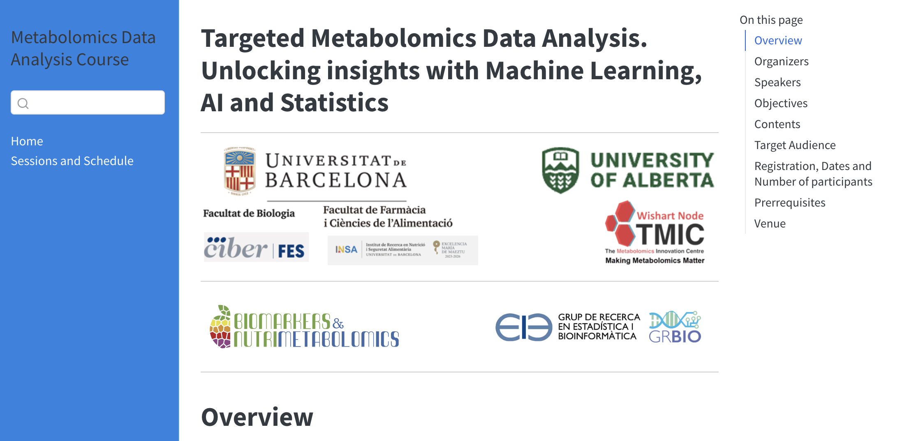
Welcome

Slide 3


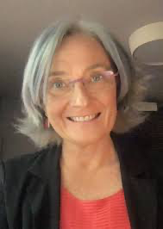

Your Instructors/Speakers
David Wishart
Alex Sanchez-Pla
Cristina Andrés-Lacueva
Xavier Nogués

Slide 4
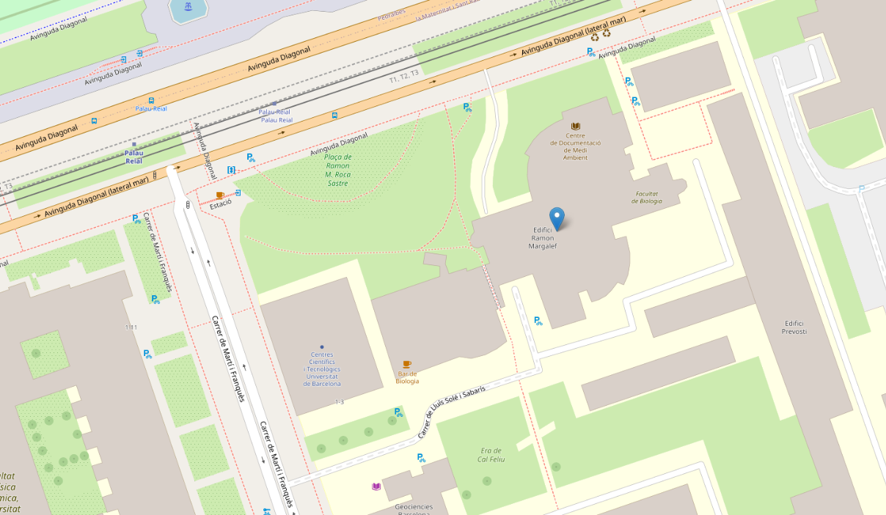
The Map
Hill Side
Lectures: Classroom A14, Durfort Building
Washrooms: Basefloor, Durfort building
Cafeteria: Underground floor, Durfort Building
Metro Station: Palau Reial
What to do in case of fire / emergencies ?
Durfort Building
Classroom: A14
(1st floor)
Wifi: Eduroam (or ask for it if you don’t have it)
Sea Side

Slide 5
Other Information
Washroom locations??
Fire and Emergency information??
Wifi access??
Where to eat for lunch
Where coffee breaks will be
Please Provide this Information – I don’t have it

Slide 6

Tell Us About You
Your Name
Where you are from
What you do/what you study
Why you decided to take the course
What you want from the course
Something interesting about you or your background

Slide 7
General Course Outline
Mix of hands-on and lecture-based instruction
General introduction to metabolomics
Learn about targeted metabolomics assays and their design
Understand the advantages and limitations of targeted metabolomics
Introduce students to bioinformatics workflows for processing and analyzing metabolomic data
Learn how to apply statistics and machine learning to perform metabolomics data analysis

Slide 8
Course Materials
Most material will be accessible through the course’s Google Drive
It is important that you have a working laptop
Access to that Google Drive has been sent to you via an email (sent today)
Please download the slides or documents to your laptops on an as-needed basis
If you can’t access the drive or download the files, let us know and we can email the material to you

Slide 9
Agenda (Day 1)
Time | Activity
8:30 – 9;00 | Arrival
9:00 – 9:30 | Introductions and Orientation. Institutional Welcome
9:30 – 10:30 | Introduction to Metabolomics
10:30 – 11:00 | Coffee
11:00 – 12:00 | Metabolomics Data and Databases
12:00 – 13:00 | Targeted vs. Untargeted Metabolomics
13:00 – 14:00 | Lunch
14:00 – 15:00 | Quantification in MS-based Metabolomics
15:00 – 15:30 pm | Isotopic Labeling and Isotope Standards
15:30 – 16:00 pm | Coffee
16:00 – 17:00 pm | Designing a Quantitative Metabolomics Assay

Slide 10
Agenda (Day 2)
Time | Activity
8:30 – 9;00 | Arrival
9:00 – 10:30 | The MEGA Metabolomics Assay
10:30 – 11:00 | Coffee
11:00 – 12:00 | Introduction to LC-AutoFit
12:00 – 13:00 | Lab: Running LC-AutoFit on Real Data
13:00 – 14:00 | Lunch
14:00 – 15:30 | Lab: Running LC-AutoFit on Real Data
15:30 – 16:00 pm | Coffee
16:00 – 17:00 pm | Biomarkers, Ratios and Reference Data

Slide 11
Agenda (Day 3)
Time | Activity
8:30 – 9;00 | Arrival
9:00 – 10:30 | Statistics Review
10:30 – 11:00 | Coffee
11:00 – 13:00 | Machine Learning Methods and Metabolomics
13:00 – 14:00 | Lunch
14:00 – 15:30 | Introduction to MetaboAnalyst
15:30 – 16:00 pm | Coffee
16:00 – 17:00 pm | Lab: Analyzing MEGA Data with MetaboAnalyst

Slide 12
Agenda (Day 4)
Time | Activity
8:30 – 9;00 | Arrival
9:00 – 10:30 | Advanced Machine Learning Methods in Metabolomics
10:30 – 11:00 | Coffee
11:00 – 13:00 | Lab: Advanced Machine Learning Methods in Metabolomics
13:00 – 14:00 | Lunch
14:00 – 14:30 | Pathway Analysis
14:30 – 15:30 | Lab: Pathway Analysis
15:30 – 16:00 pm | Coffee
16:00 – 17:00 pm | New Frontiers in Metabolomics

Slide 13
Questions?

